Slide 1

How To Increase Revenue
Zulip

Slide 2
Way to increase revenue
Shut down station that are not generating revenue
Enhancing Customer experience
Launching new idea to service more customer

Slide 3
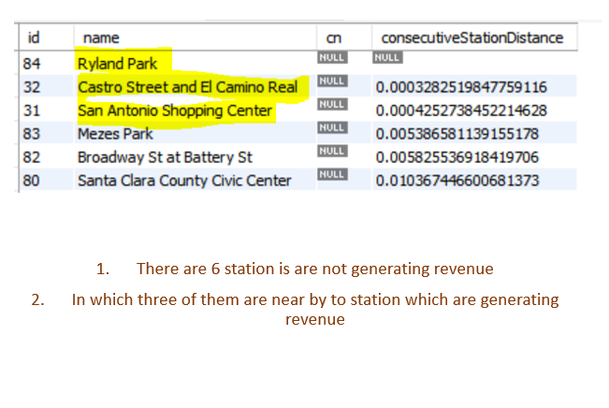
Station that are not generating revenue 1. Raylon Park 2. Castro Street and El Camino Real 3. San Antonio Shopping Center

Slide 4
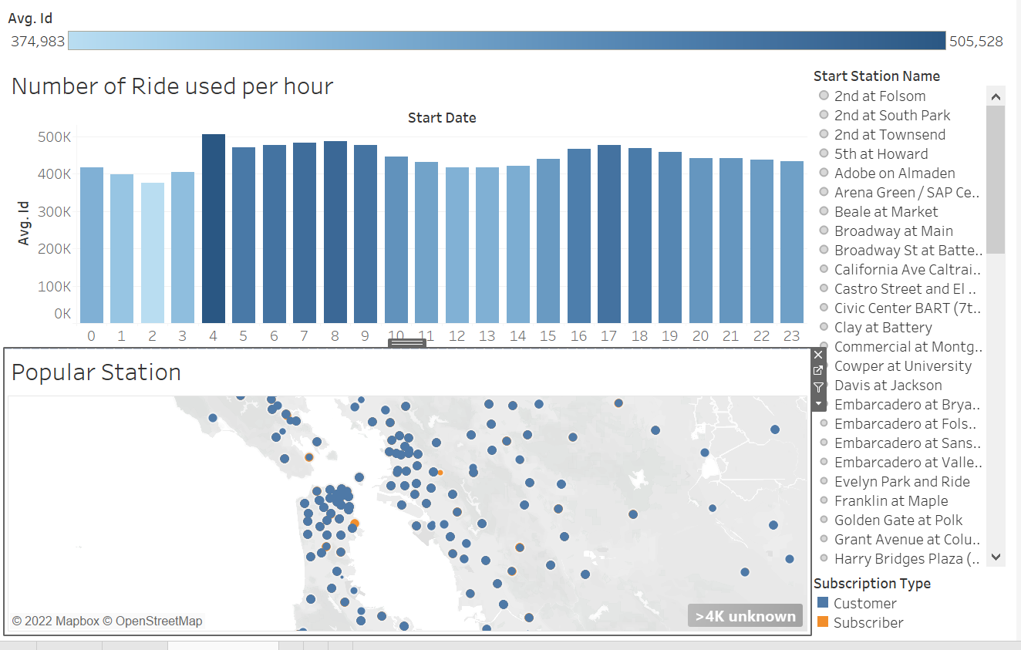
Enhancing Customer experience
cyclists earn points by renting or returning bikes at certain high-need stations(to attend supply chain demand)
We can make sure that all bikes are proper functioning that peak-up hour

Slide 5
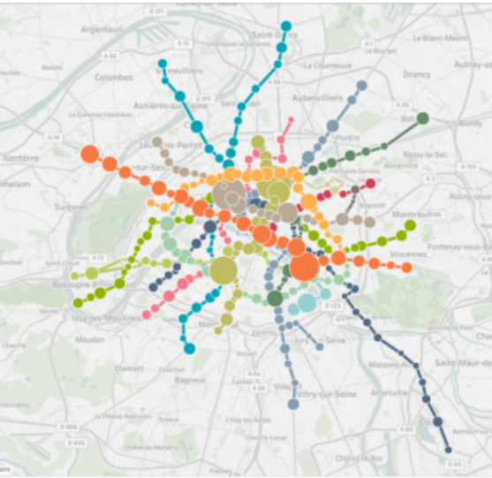
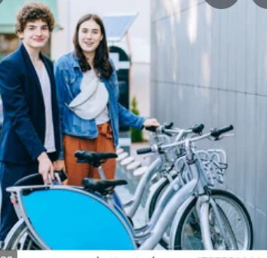
Couple Bikes
Make ride safe and joyful rides
Server more customer

